Slide 1

React Native: Bringing modern web techniques to mobile

Slide 2




Who am I ?
Adrian Zghibarța
Mobile Dev
iOS – 2 years
Xamarin – 4 months
React Native – 5 month

Slide 3
Different ways of writing a mobile app
React native.. What’s that?
React native.. How does it work? Bridging
Starting a new RN project (with a little demo)
UI.. it’s all about components
Component lifecycle
Implementing native code
Adding external native libraries
Final demo
Pros and cons
Conclusion

Slide 4
3 ways of writing a mobile app
Cross-Platform
Native
Hybrid

Slide 5
Native apps

Slide 6
Cross-Platform and Hybrid

Slide 7
Cross-platform using .NET or JavaScript

Slide 8
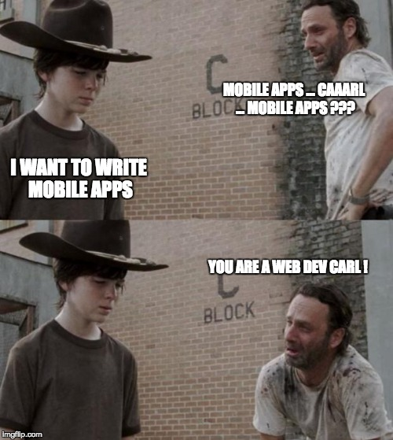
DO we have a solution ?

Slide 9
Hybrid using WEB technologies

Slide 10
REACT NATIVE Framework
Using JavaScript and React to build Native Mobile Apps … and even more

Slide 11
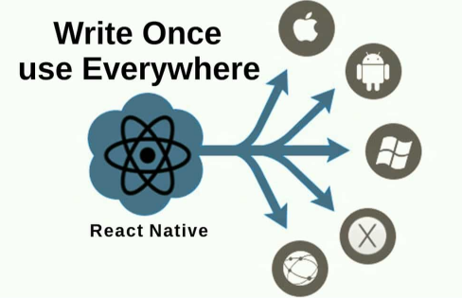

Slide 12
How does it work?
It’s all about bridging
BridgeModules
BridgeModules
JavaScript Code Base
JavaScript Runtime

Slide 13
Js runtime and syntax transformers
When using React Native, you're going to be running your JavaScript code in two environments:
On iOS simulators and devices, Android emulators and devices React Native uses JavaScriptCore
When using Chrome debugging, so you are using V8.
As of version 0.5.0, React Native ships with the Babel JavaScript compiler.

Slide 14

What do we need to start a RN project?
All what we need is …

Slide 15
Let’s be more serious
All what you need is:
Environment Setup
brew install node
brew install watchman
npm install -g react-native-cli
react-native init AwesomeProject
cd AwesomeProject
react-native run-ios
react-native run-android
Project initialization

Slide 17
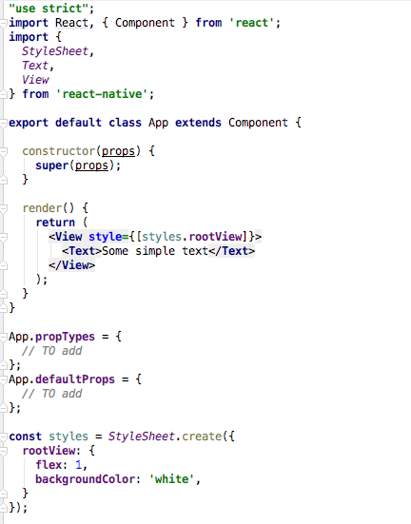
How does UI Work ?
In terms of defining UI, we have the same JSX from React
JS Code + UI Tags + Style -> in the same file
High level of modularization .. A lot of components

Slide 18
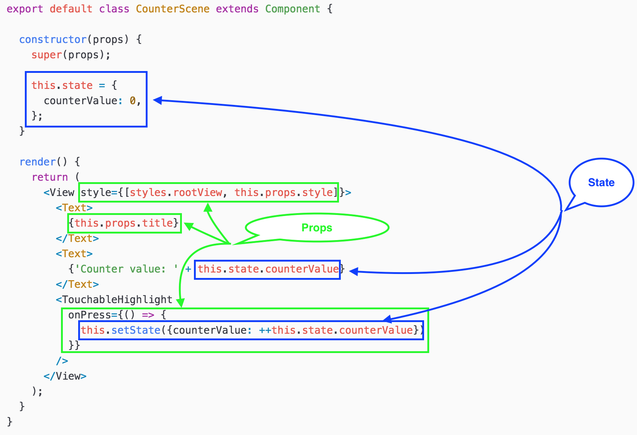
What is the atomic part of RN UI?
It’s all about components, props, and state!

Slide 19
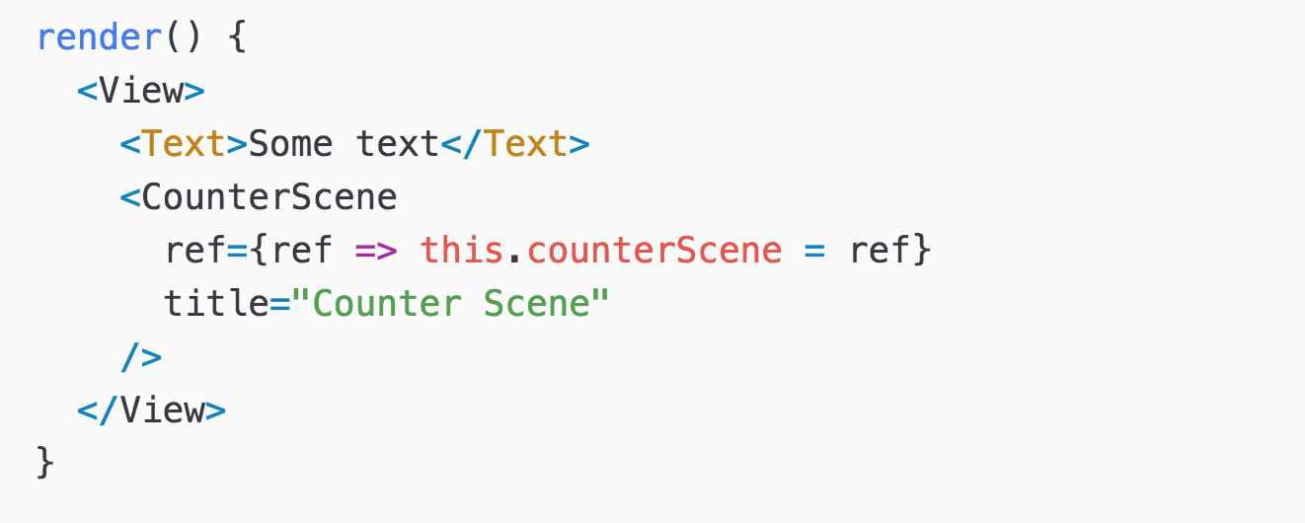
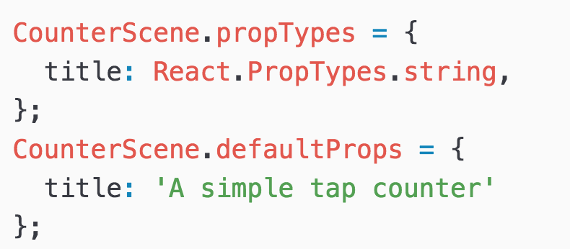
Using our new Component
Same as using a RN default component
Used in the render method of another component
Using and defining default props and props types

Slide 20
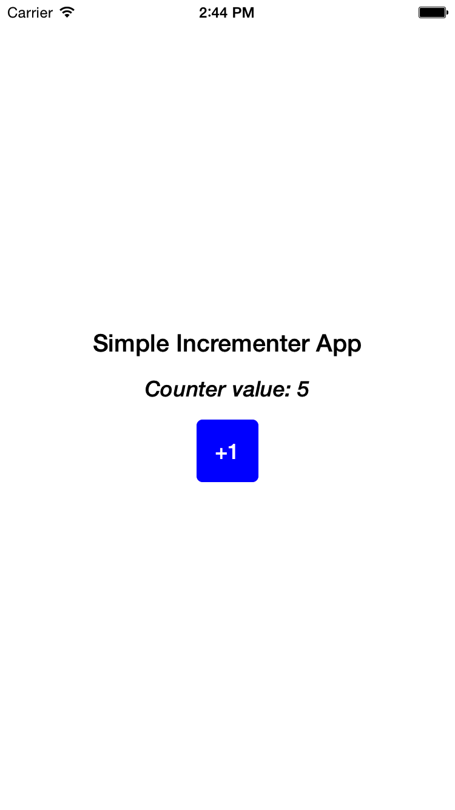
Incrementer APP

Slide 21
Component lifecycle

Slide 22
How does UI Works ?
Does react native have a ‘Virutal DOM’ ?
React builds and maintains an internal representation of the rendered UI. This representation lets React avoid creating DOM nodes and accessing existing ones beyond necessity. Sometimes it is referred to as a "virtual DOM", but it works the same way on React Native.

Slide 23
Implementing native code
On iOS a native module is just an Objective-C class that implements the RCTBridgeModuleprotocol.
On Android a native module is a Java class that usually extends the ReactContextBaseJavaModule class and is exported as a module.
To make it simpler to access your new functionality from JavaScript, it is common to wrap the native module in a JavaScript module, and also that give you the ability to add more JS logic.
Native code is async code by default so we need to use callbacks or promises
Java class
Objective-C class
JavaScript Module

Slide 24
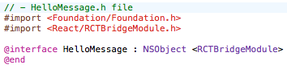
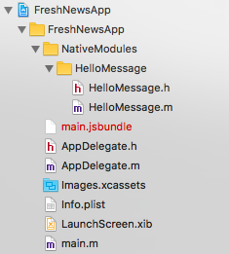
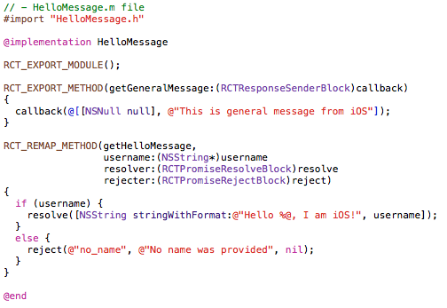
Add your own Native module iOS
With callbacks and promise

Slide 25
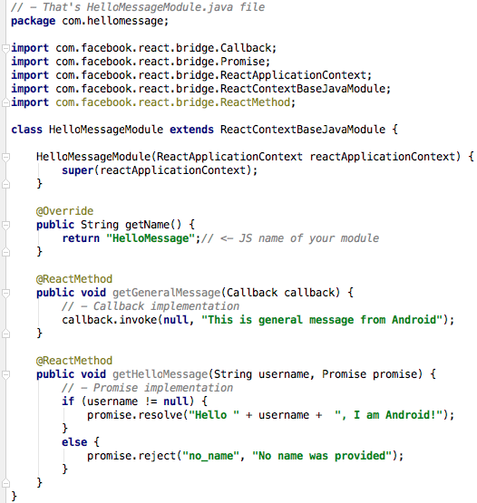
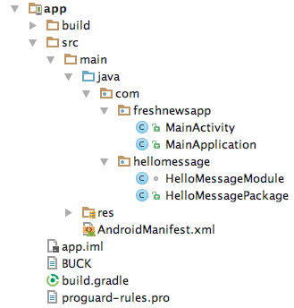
Add your own Native module Android – Adding the module
With callbacks and promise

Slide 26
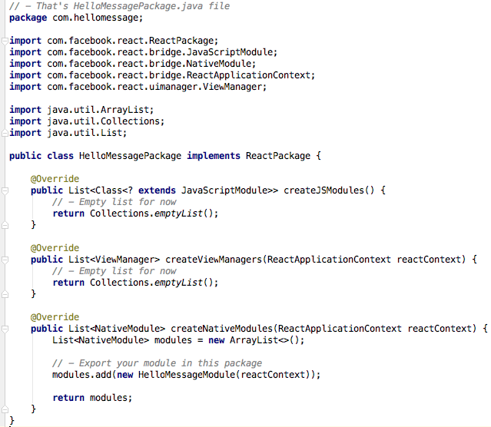
Add your own Native module Android – Adding the Package

Slide 27
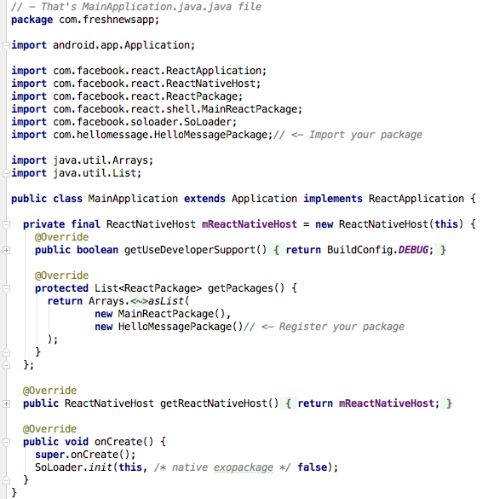
Add your own Native module Android – REGISTERING THE PACKAGE

Slide 28
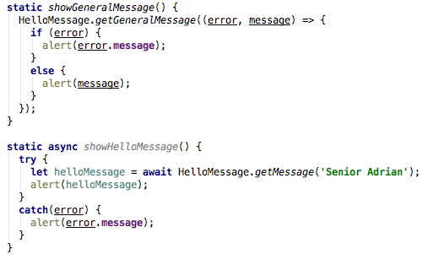
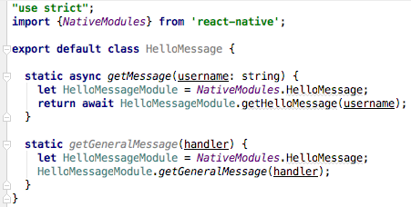
ADD Your Own native module – how to use it in JS

Slide 31
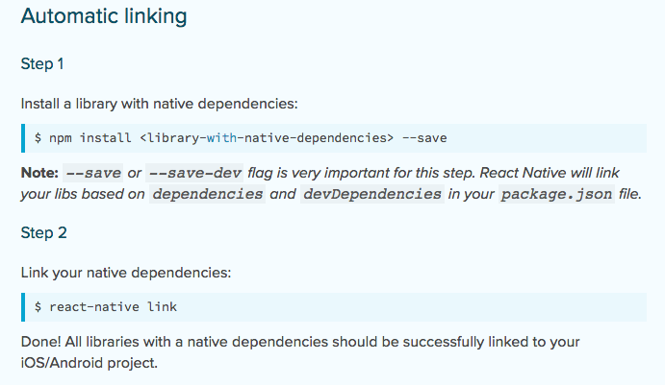
Adding external Native modules
If you are lucky… automatic linking

Slide 32
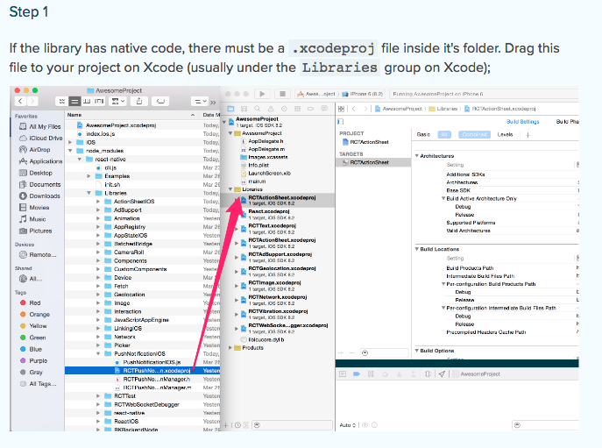
Adding external Native modules - ios
If you are not so lucky… manual linking

Slide 33
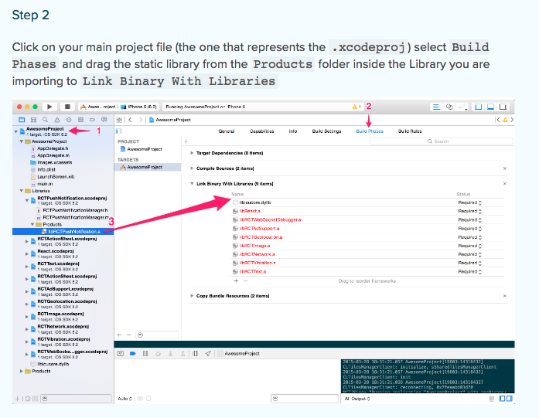
Adding external Native modules - ios
If you are not so lucky… manual linking

Slide 34
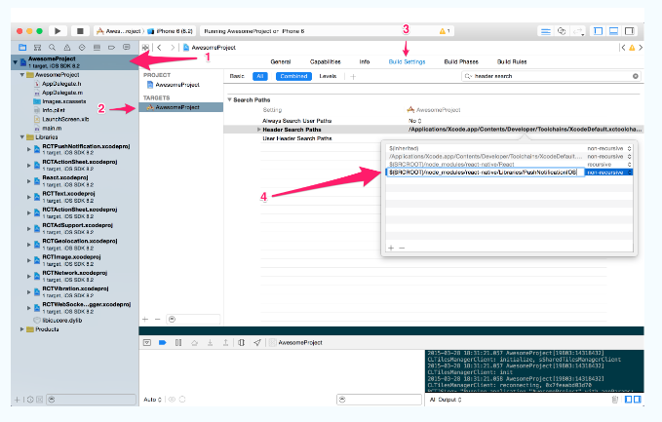
Adding external Native modules - ios
If you are not lucky at all… manual linking

Slide 35
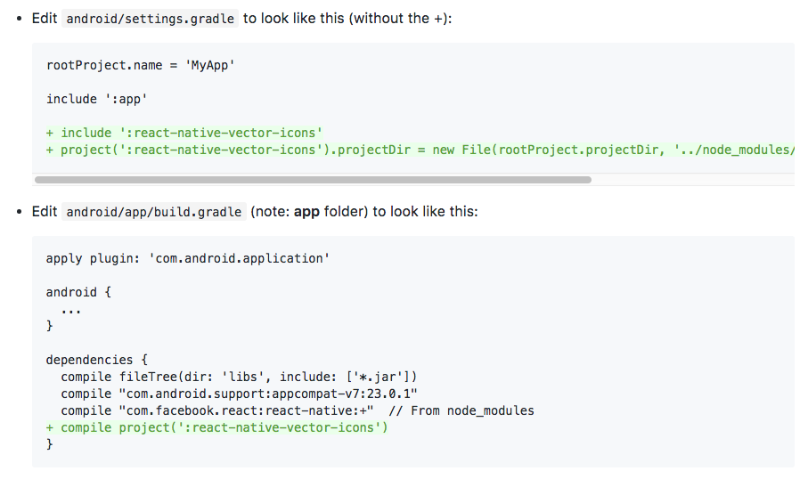
Adding external Native modules - Android
If you are not so lucky… manual linking

Slide 36
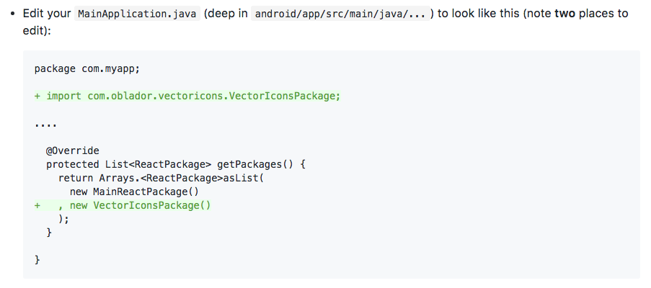
Adding external Native modules - Android
If you are not so lucky… manual linking

Slide 37
Manual linking is evil
My first reaction? .. But you get used to it ☺

Slide 38
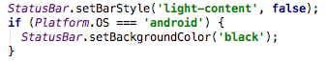

How to know make the difference between ios and android at runtime?
Use Platform.OS
Use different file extensions

Slide 40
Business conclusion
2x Time
1.4 – 1.8 Time
1 – 1.3 Time
100% Performance
80% Performance
60% Performance

Slide 41
React native
What you need to know?

Slide 42
Pros and cons
Use a well known philosophy (React.js)
Uses almost all futures of JS / Node.js libraries
Is native -> Performant
Familiar for web devs
Great cross platform UI implementation
Great community
Fast release of new versions
Good documentation .. But not perfect
It’s not stable
New versions can break old projects
We need more external libraries
Implementing data flow is a hell (Flux / Redux)
Debugging … pfff .. What’s that?
JS .. Not type safe
Management of multiple native projects
iOS is better implemented that Android
Don’t have a UI previewer

Slide 43

My experience with RN part 1

Slide 44

My experience with RN part 2

Slide 45

My experience with RN part 3
You need to try it!

Slide 46
Is this the best solution for mobile dev?
A hell of a question …

